Slide 1
HDAR
Data model and query testing

Slide 2
All Tables

Slide 3
Active Tables

Slide 4
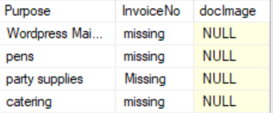
Expense Actual Table

Slide 5
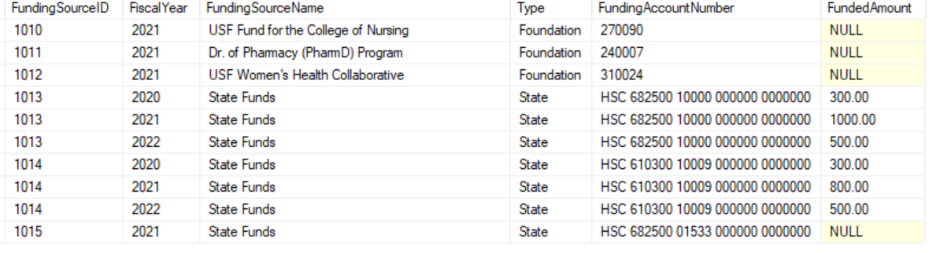
Funding Source table

Slide 6
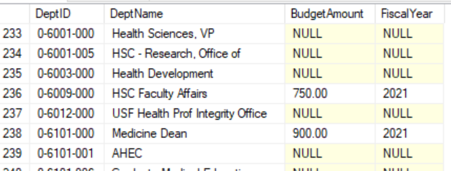
Department table

Slide 7
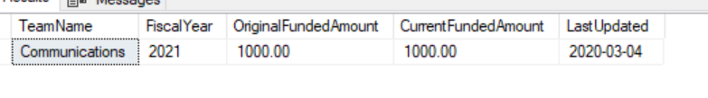
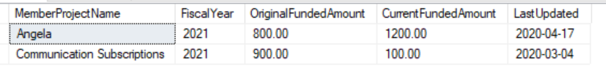
Team table
Member/Project table

